Slide 1
Phase Transition in Classical analog of a Model in Synthetic Dimension
Yutan Zhang
September, 2021

Slide 2
Outline
What is Synthetic Dimension?
Phase Transitions in General
My Model
Methodology: Classical Monte Carlo
Results
Future Plan

Slide 3
Synthetic Dimensions – What Is It?
To explore physics in a higher dimensionality then its geometrical dimension
Dimensionality depends on how the states are coupled

Slide 4
Significance of Synthetic dimension
Explore higher dimensional physics
Easy to synthesize and control
Useful in communication
Effective gauge potential to control frequency etc. of light
Useful in experimentally realizing physical systems:
Synthetic band structure, including topological ones
Create strong correlated matter
Engineering topology of the lattice and the boundary condition

Slide 5

Experimental Realization

Slide 6
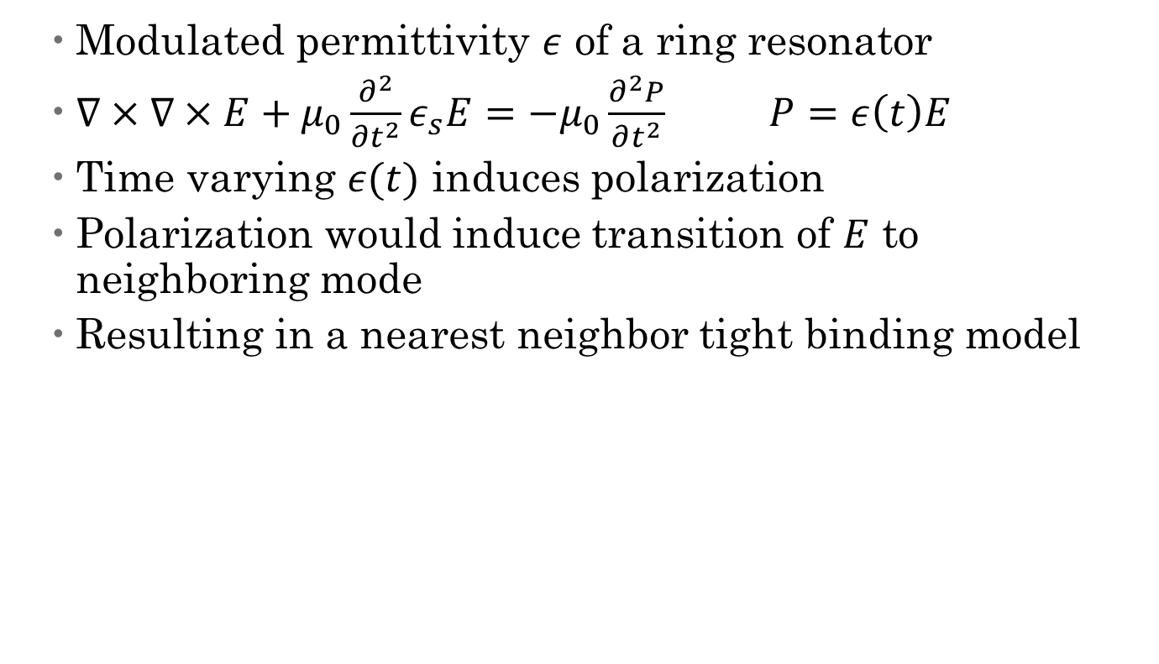
Optical Method
Modulated permittivity $ε$ of a ring resonator
$∇×∇×E+μ_{0}\frac{∂^{2}}{∂t^{2}}ε_{s}E=−μ_{0}\frac{∂^{2}P}{∂t^{2}}$ $P=ε\left(t\right)E$
Time varying $ε(t)$ induces polarization
Polarization would induce transition of $E$ to neighboring mode
Resulting in a nearest neighbor tight binding model

Slide 7
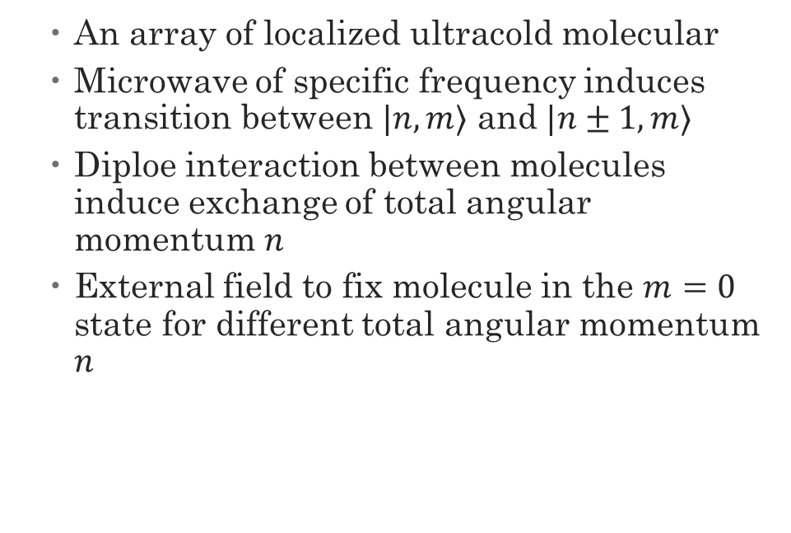
Ultracold polar molecular array in Microwave – the system we study
An array of localized ultracold molecular
Microwave of specific frequency induces transition between $|n,m⟩$ and $|n±1,m⟩$
Diploe interaction between molecules induce exchange of total angular momentum $n$
External field to fix molecule in the $m=0$ state for different total angular momentum $n$

Slide 8

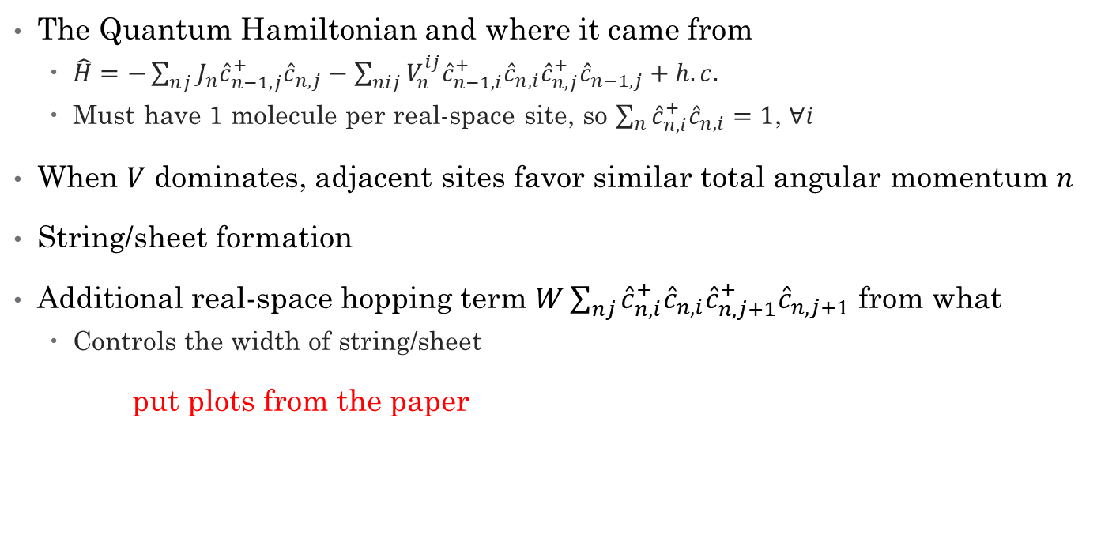
The Quantum Hamiltonian & String/Sheet Formation
The Quantum Hamiltonian and where it came from
$\hat{H}=−\sum_{nj}{J_{n}{\hat{c}}_{n−1,j}^{+}{\hat{c}}_{n,j}}−\sum_{nij}{V_{n}^{ij}{\hat{c}}_{n−1,i}^{+}{\hat{c}}_{n,i}{\hat{c}}_{n,j}^{+}{\hat{c}}_{n−1,j}}+h.c.$
Must have 1 molecule per real-space site, so $\sum_{n}{{\hat{c}}_{n,i}^{+}{\hat{c}}_{n,i}}=1$, $∀i$
When $V$ dominates, adjacent sites favor similar total angular momentum $n$
String/sheet formation
Additional real-space hopping term $W\sum_{nj}{{\hat{c}}_{n,i}^{+}{\hat{c}}_{n,i}{\hat{c}}_{n,j+1}^{+}{\hat{c}}_{n,j+1}}$ from what
Controls the width of string/sheet
put plots from the paper

Slide 9

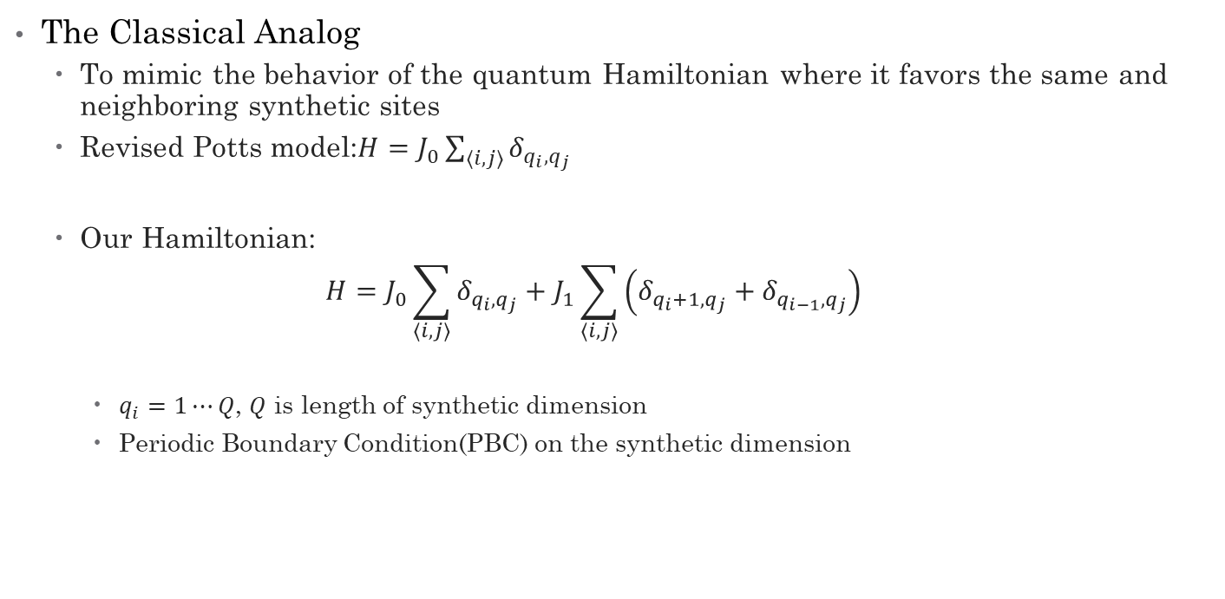
Classical Analog & Our Model
The Classical Analog
To mimic the behavior of the quantum Hamiltonian where it favors the same and neighboring synthetic sites
Revised Potts model:$H=J_{0}\sum_{⟨i,j⟩}{δ_{q_{i},q_{j}}}$
Our Hamiltonian:
$$H=J_{0}\sum_{⟨i,j⟩}{δ_{q_{i},q_{j}}}+J_{1}\sum_{⟨i,j⟩}{\left(δ_{q_{i}+1,q_{j}}+δ_{q_{i−1},q_{j}}\right)}$$
$q_{i}=1⋯Q$, $Q$ is length of synthetic dimension
Periodic Boundary Condition(PBC) on the synthetic dimension

Slide 10

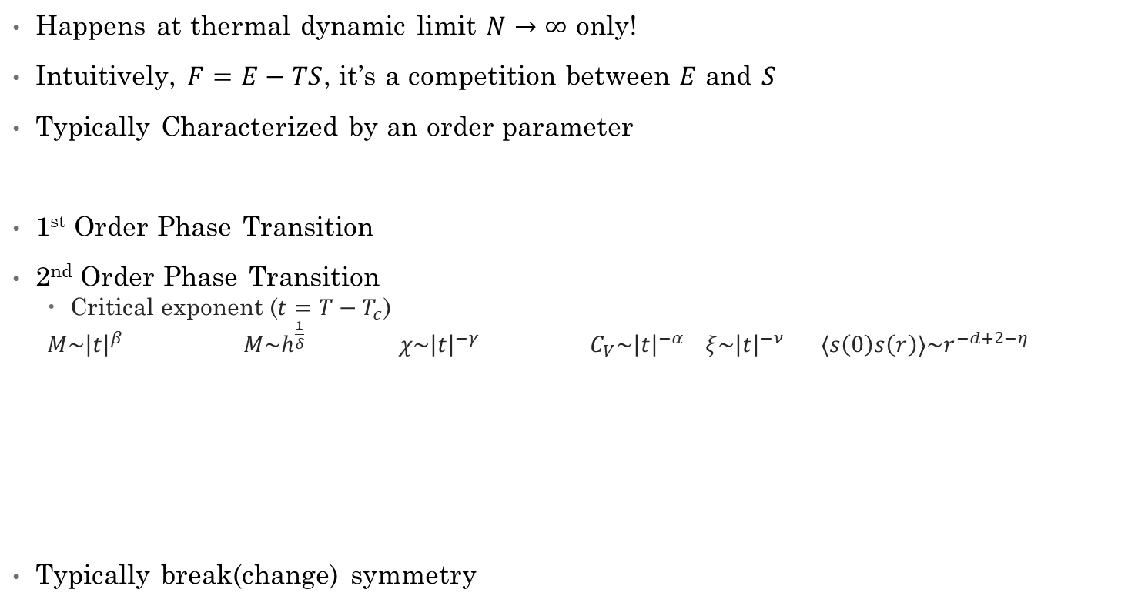
Phase transitions in general
Happens at thermal dynamic limit $N→∞$ only!
Intuitively, $F=E−TS$, it’s a competition between $E$ and $S$
Typically Characterized by an order parameter
1st Order Phase Transition
2nd Order Phase Transition
Critical exponent ($t=T−T_{c}$)
$M\sim {\left|t\right|}^{β}$ $M\sim h^{\frac{1}{δ}}$ $χ\sim {\left|t\right|}^{−γ}$ $C_{V}\sim {\left|t\right|}^{−α}$ $ξ\sim {\left|t\right|}^{−ν}$ $⟨s\left(0\right)s\left(r\right)⟩\sim r^{−d+2−η}$
Typically break(change) symmetry

Slide 11


Monte Carlo Method
Goal: Sampling the Boltzmann distribution:
$P\left(\left\{x_{i}\right\}\right)=\frac{e^{−βE\left(\left\{x_{i}\right\}\right)} }{Z}$ $Z=\sum_{\left\{x_{i}\right\}}{e^{βE\left(\left\{x_{i}\right\}\right)}}$ $β=\frac{1}{T}$
Difficulty: Only know the probability ratio between two microstates
Method: Using a Markov Process to Randomly Generate Samples
Starting with a random configuration
Transit to a new configuration according to a transition matrix $T_{ij}$

Slide 12
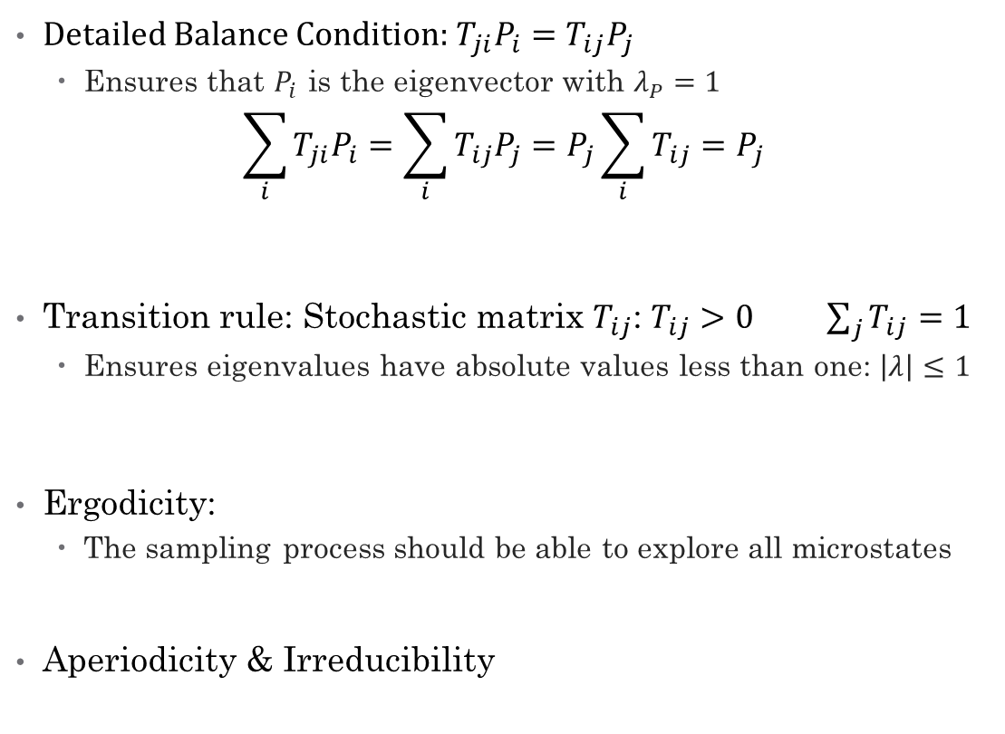
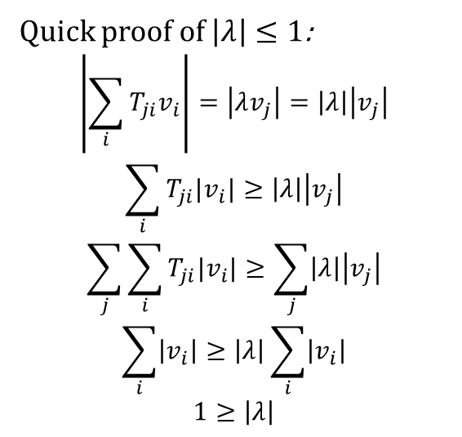
How and why does it work?
Detailed Balance Condition: $T_{ji}P_{i}=T_{ij}P_{j}$
Ensures that $P_{i}$ is the eigenvector with $λ_{P}=1$
$$\sum_{i}{T_{ji}P_{i}}=\sum_{i}{T_{ij}P_{j}}=P_{j}\sum_{i}{T_{ij}}=P_{j}$$
Transition rule: Stochastic matrix $T_{ij}$:$T_{ij}>0$ $\sum_{j}{T_{ij}}=1$
Ensures eigenvalues have absolute values less than one: $\left|λ\right|≤1$
Ergodicity:
The sampling process should be able to explore all microstates
Aperiodicity & Irreducibility
Quick proof of $\left|λ\right|≤1$:
$$\left|\sum_{i}{T_{ji}v_{i}}\right|=\left|λv_{j}\right|=\left|λ\right|\left|v_{j}\right|$$
$$\sum_{i}{T_{ji}|v_{i}|}≥\left|λ\right|\left|v_{j}\right|$$
$$\sum_{j}{\sum_{i}{T_{ji}|v_{i}|}}≥\sum_{j}{\left|λ\right|\left|v_{j}\right|}$$
$$\sum_{i}{\left|v_{i}\right|}≥\left|λ\right|\sum_{i}{\left|v_{i}\right|}$$
$$1≥\left|λ\right|$$

Slide 13
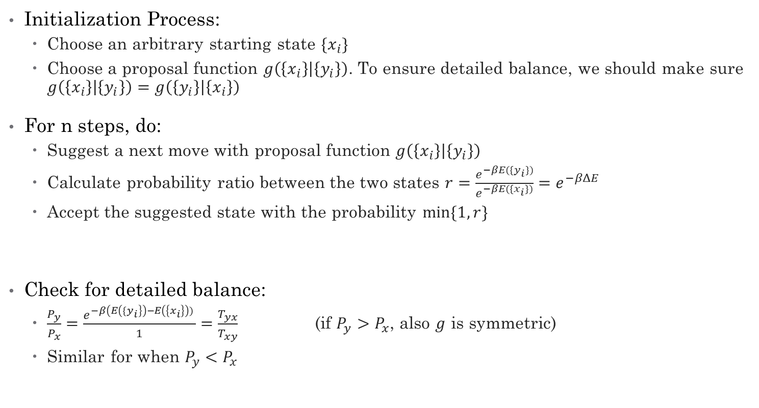
Metropolis Algorithm
Initialization Process:
Choose an arbitrary starting state $\{x_{i}\}$
Choose a proposal function $g\left(\left\{x_{i}\right\} | \left\{y_{i}\right\}\right)$. To ensure detailed balance, we should make sure $g\left(\left\{x_{i}\right\} | \left\{y_{i}\right\}\right)=g\left(\left\{y_{i}\right\} | \left\{x_{i}\right\}\right)$
For n steps, do:
Suggest a next move with proposal function $g\left(\left\{x_{i}\right\} | \left\{y_{i}\right\}\right)$
Calculate probability ratio between the two states $r=\frac{e^{−βE(\{y_{i}\})}}{e^{−βE(\{x_{i}\})}}=e^{−βΔE}$
Accept the suggested state with the probability $min⁡\{1, r\}$
Check for detailed balance:
$\frac{P_{y}}{P_{x}}=\frac{e^{−β\left(E\left({\{y}_{i}\right\}\right)−E\left(\left\{x_{i}\right\}\right)) }}{1}=\frac{T_{yx}}{T_{xy}}$ (if $P_{y}>P_{x}$, also $g$ is symmetric)
Similar for when $P_{y}<P_{x}$

Slide 14
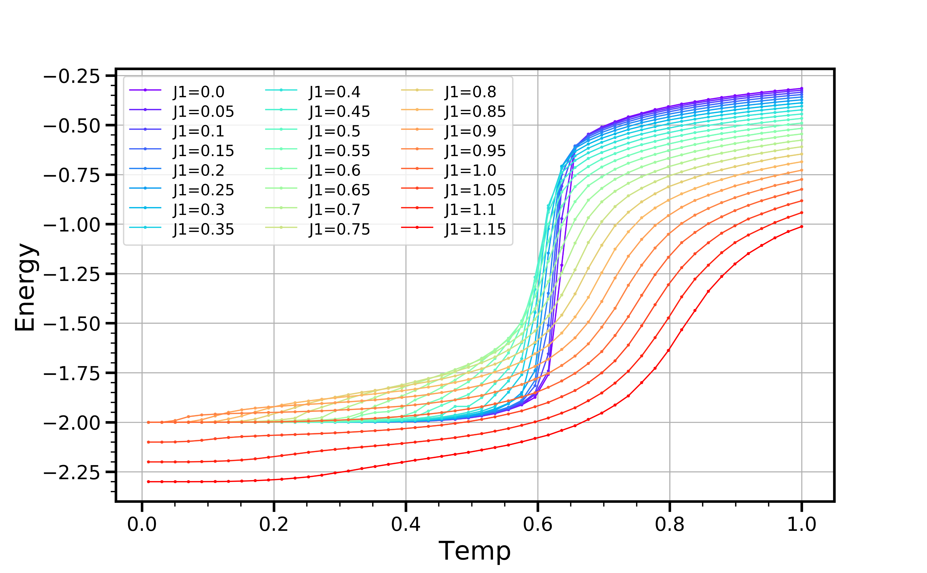
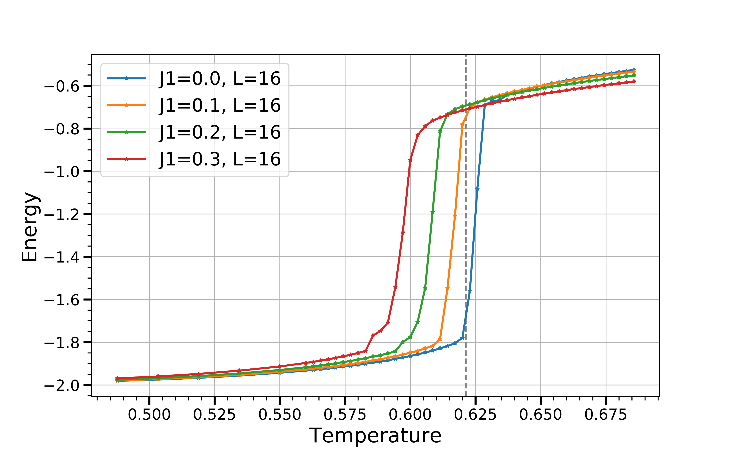

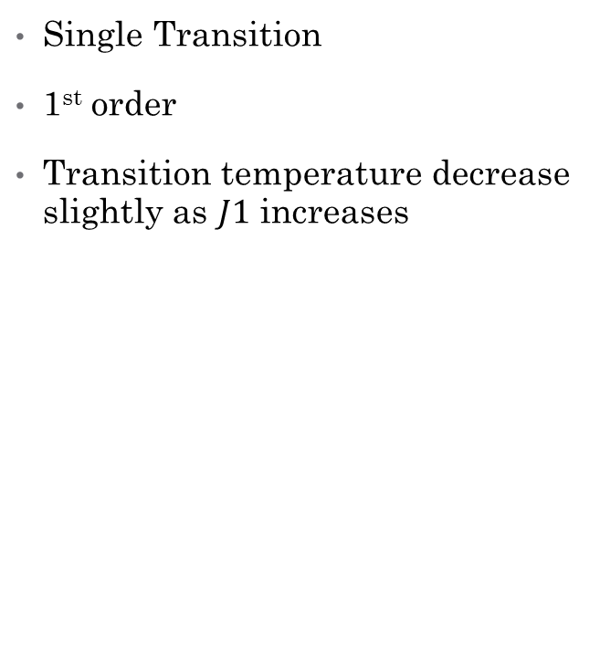
When $J_{1}$ is small (show E, maybe another one with only small $J_{1}$)
Single Transition
1st order
Transition temperature decrease slightly as $J1$ increases

Slide 15


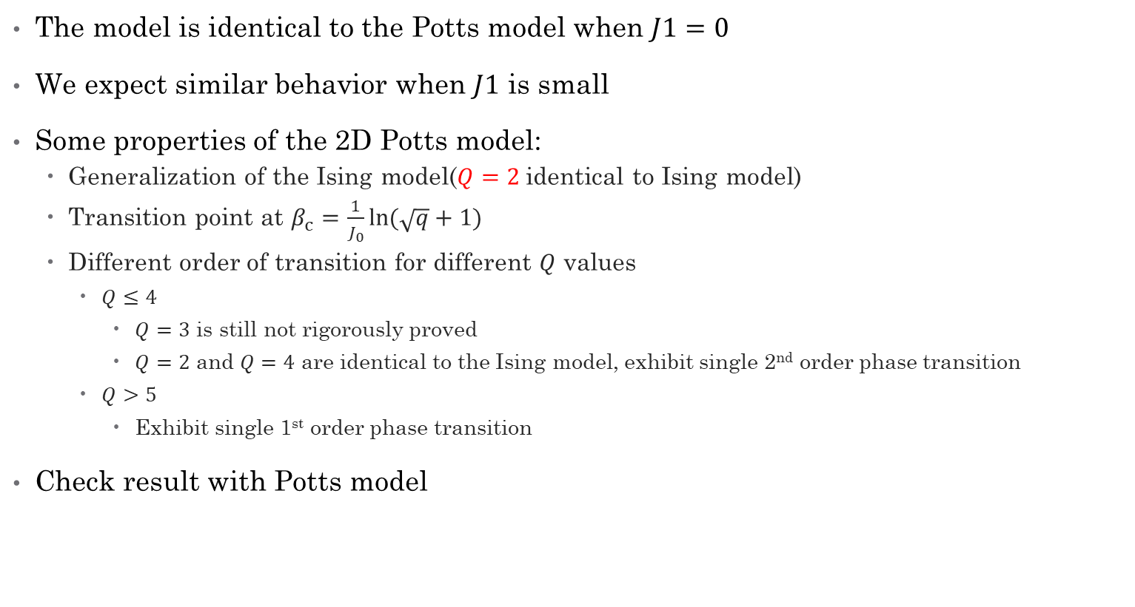
Potts Model : $H=−J_{0}\sum_{⟨i,j⟩}{δ_{q_{i},q_{j}}}$
The model is identical to the Potts model when $J1=0$
We expect similar behavior when $J1$ is small
Some properties of the 2D Potts model:
Generalization of the Ising model($Q=2$identical to Ising model)
Transition point at $β_{c}=\frac{1}{J_{0}}ln⁡(\sqrt{q}+1)$
Different order of transition for different $Q$ values
$Q≤4$
$Q=3$ is still not rigorously proved
$Q=2$ and $Q=4$ are identical to the Ising model, exhibit single 2nd order phase transition
$Q>5$
Exhibit single 1st order phase transition
Check result with Potts model

Slide 16
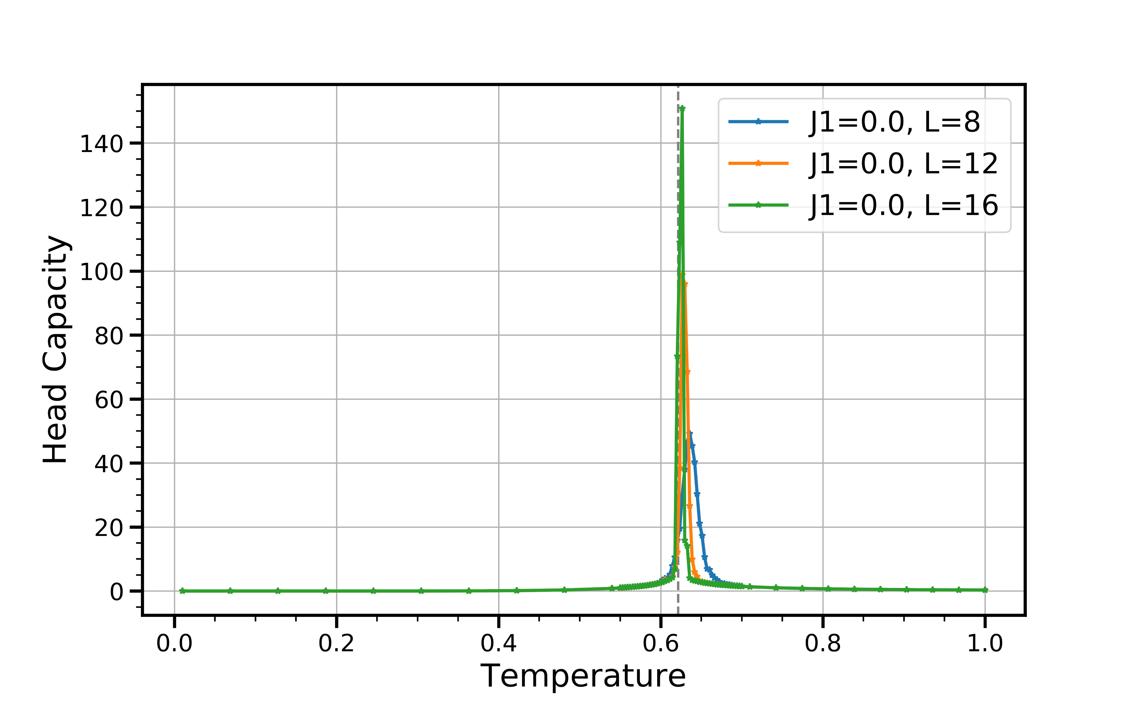
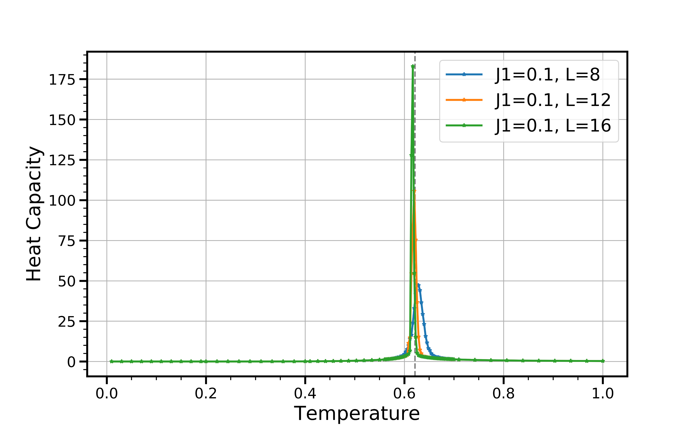
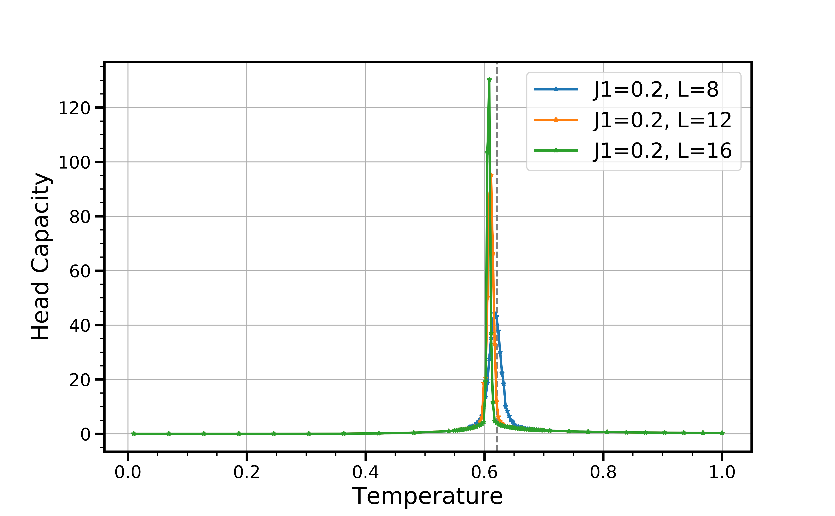
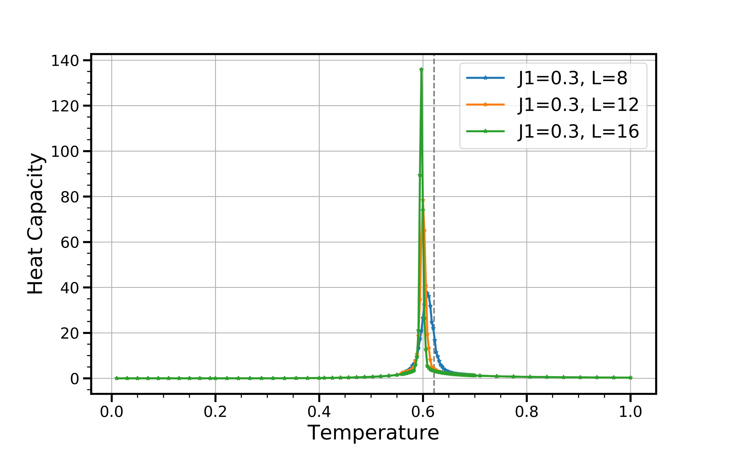

Slide 17
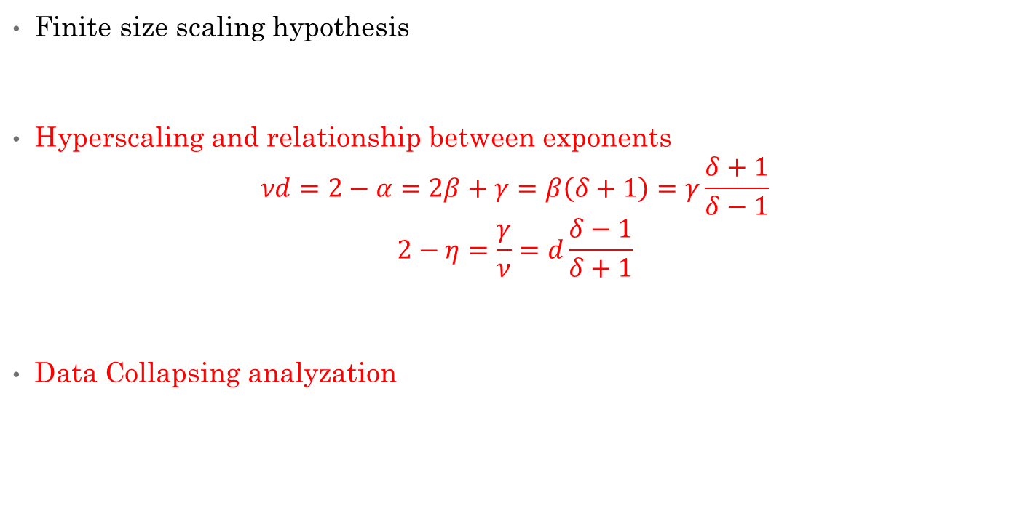
Finite Size Scaling
Finite size scaling hypothesis
Hyperscaling and relationship between exponents
$$νd=2−α=2β+γ=β\left(δ+1\right)=γ\frac{δ+1}{δ−1}$$
$$2−η=\frac{γ}{ν}=d\frac{δ−1}{δ+1}$$
Data Collapsing analyzation

Slide 18
Binder’s ratio crossing?

Slide 19
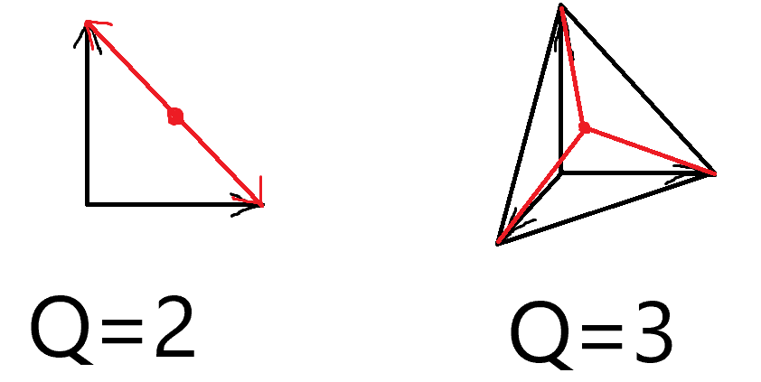
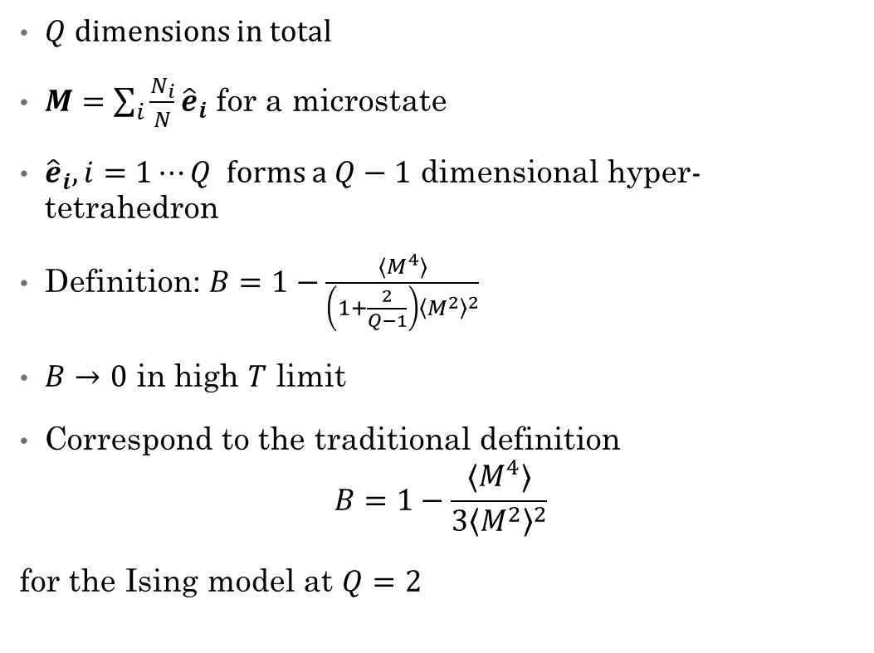
Defining Binder’s Ratio in Our Model
$Q$ dimensions in total
$M=\sum_{i}{\frac{N_{i}}{N}}{\hat{e}}_{i}$ for a microstate
${\hat{e}}_{i},i=1⋯Q$ forms a $Q−1$ dimensional hyper-tetrahedron
Definition: $B=1−\frac{⟨M^{4}⟩}{\left(1+\frac{2}{Q−1}\right){\left\langle M^{2}\right\rangle }^{2}}$
$B→0$ in high $T$ limit
Correspond to the traditional definition
$$B=1−\frac{⟨M^{4}⟩}{3{\left\langle M^{2}\right\rangle }^{2}}$$
for the Ising model at $Q=2$

Slide 20
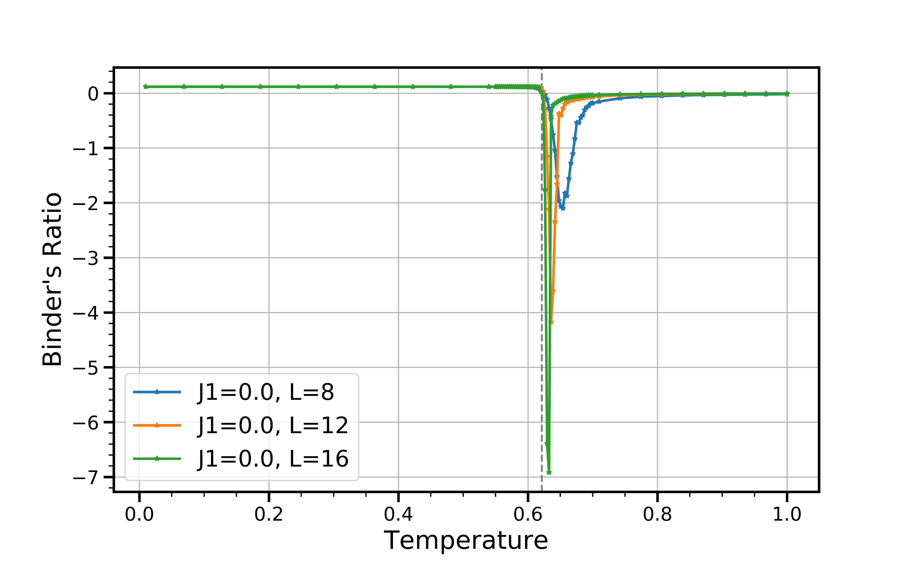
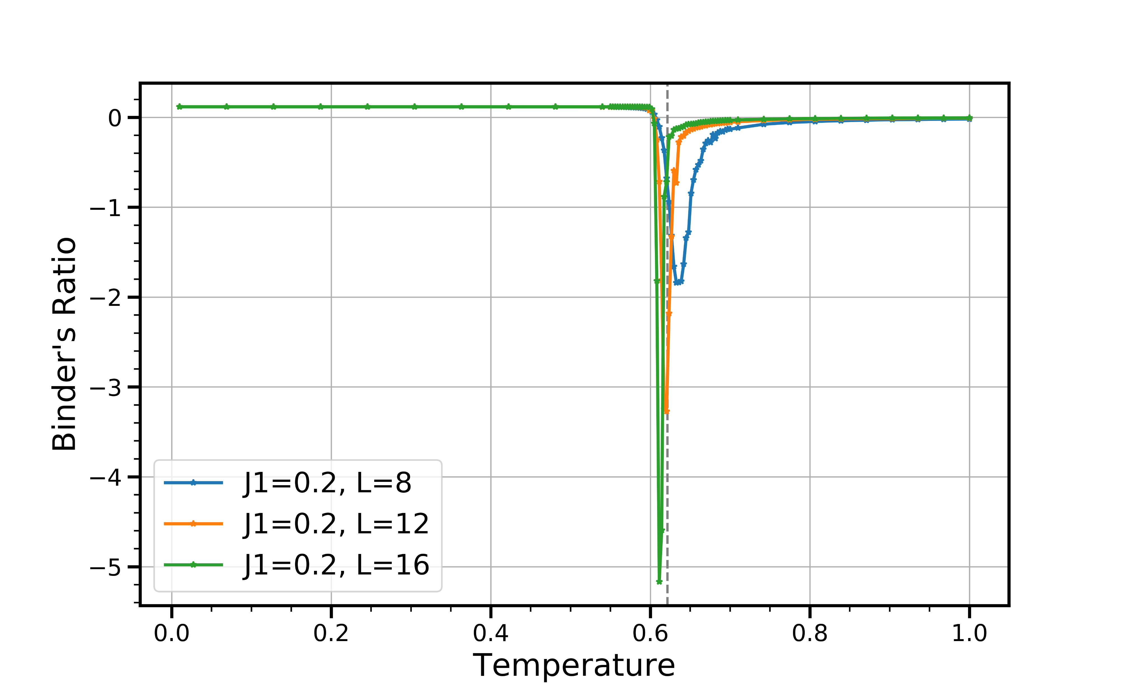

Binder’s ratio when $J_{1}$ is small

Slide 21
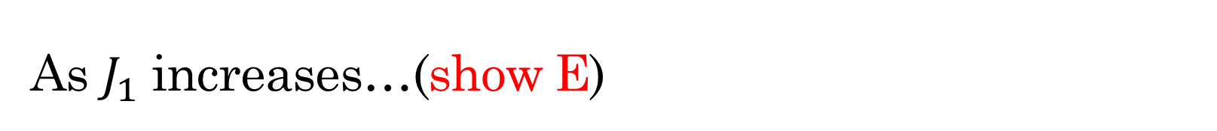
As $J_{1}$ increases…(show E)
Starting to show two peaks in heat capacity
Peak sizes have no difference for different L
Suggesting two phase transitions

Slide 22
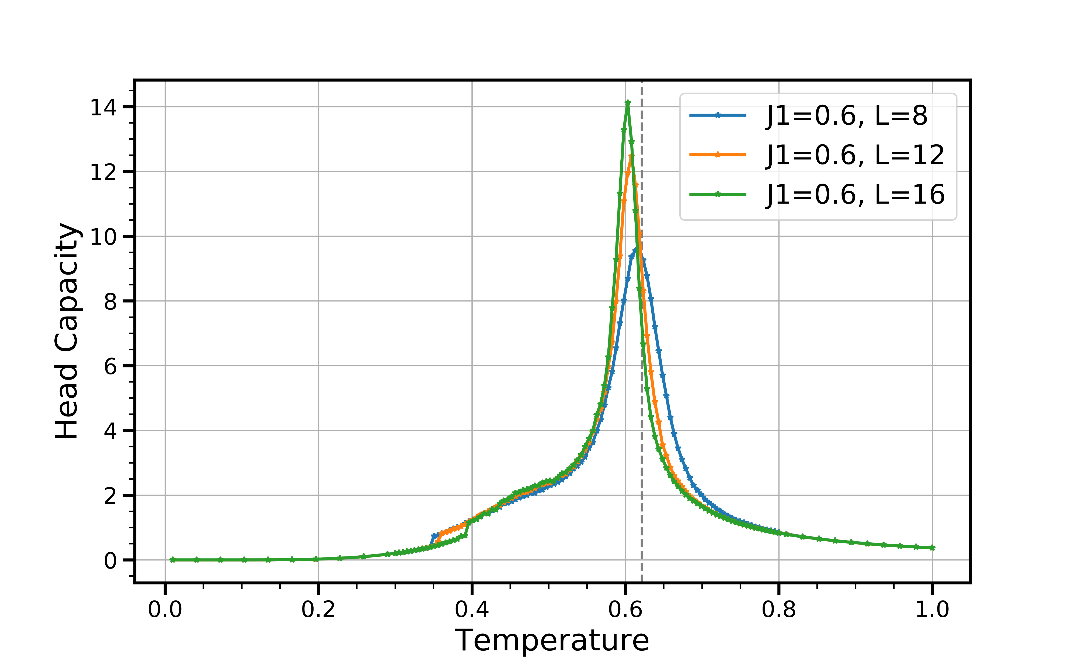
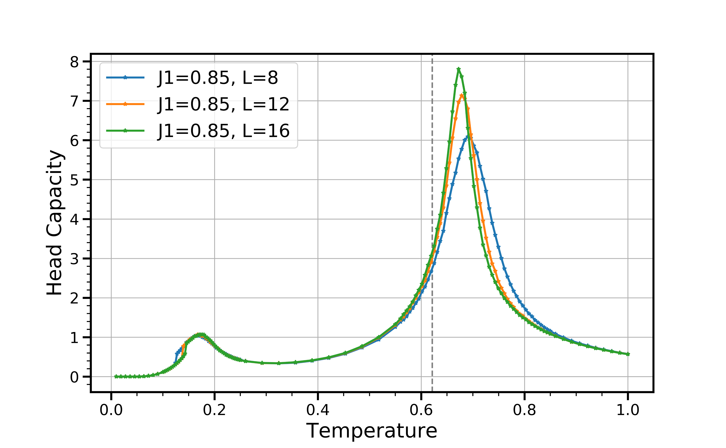

Slide 23
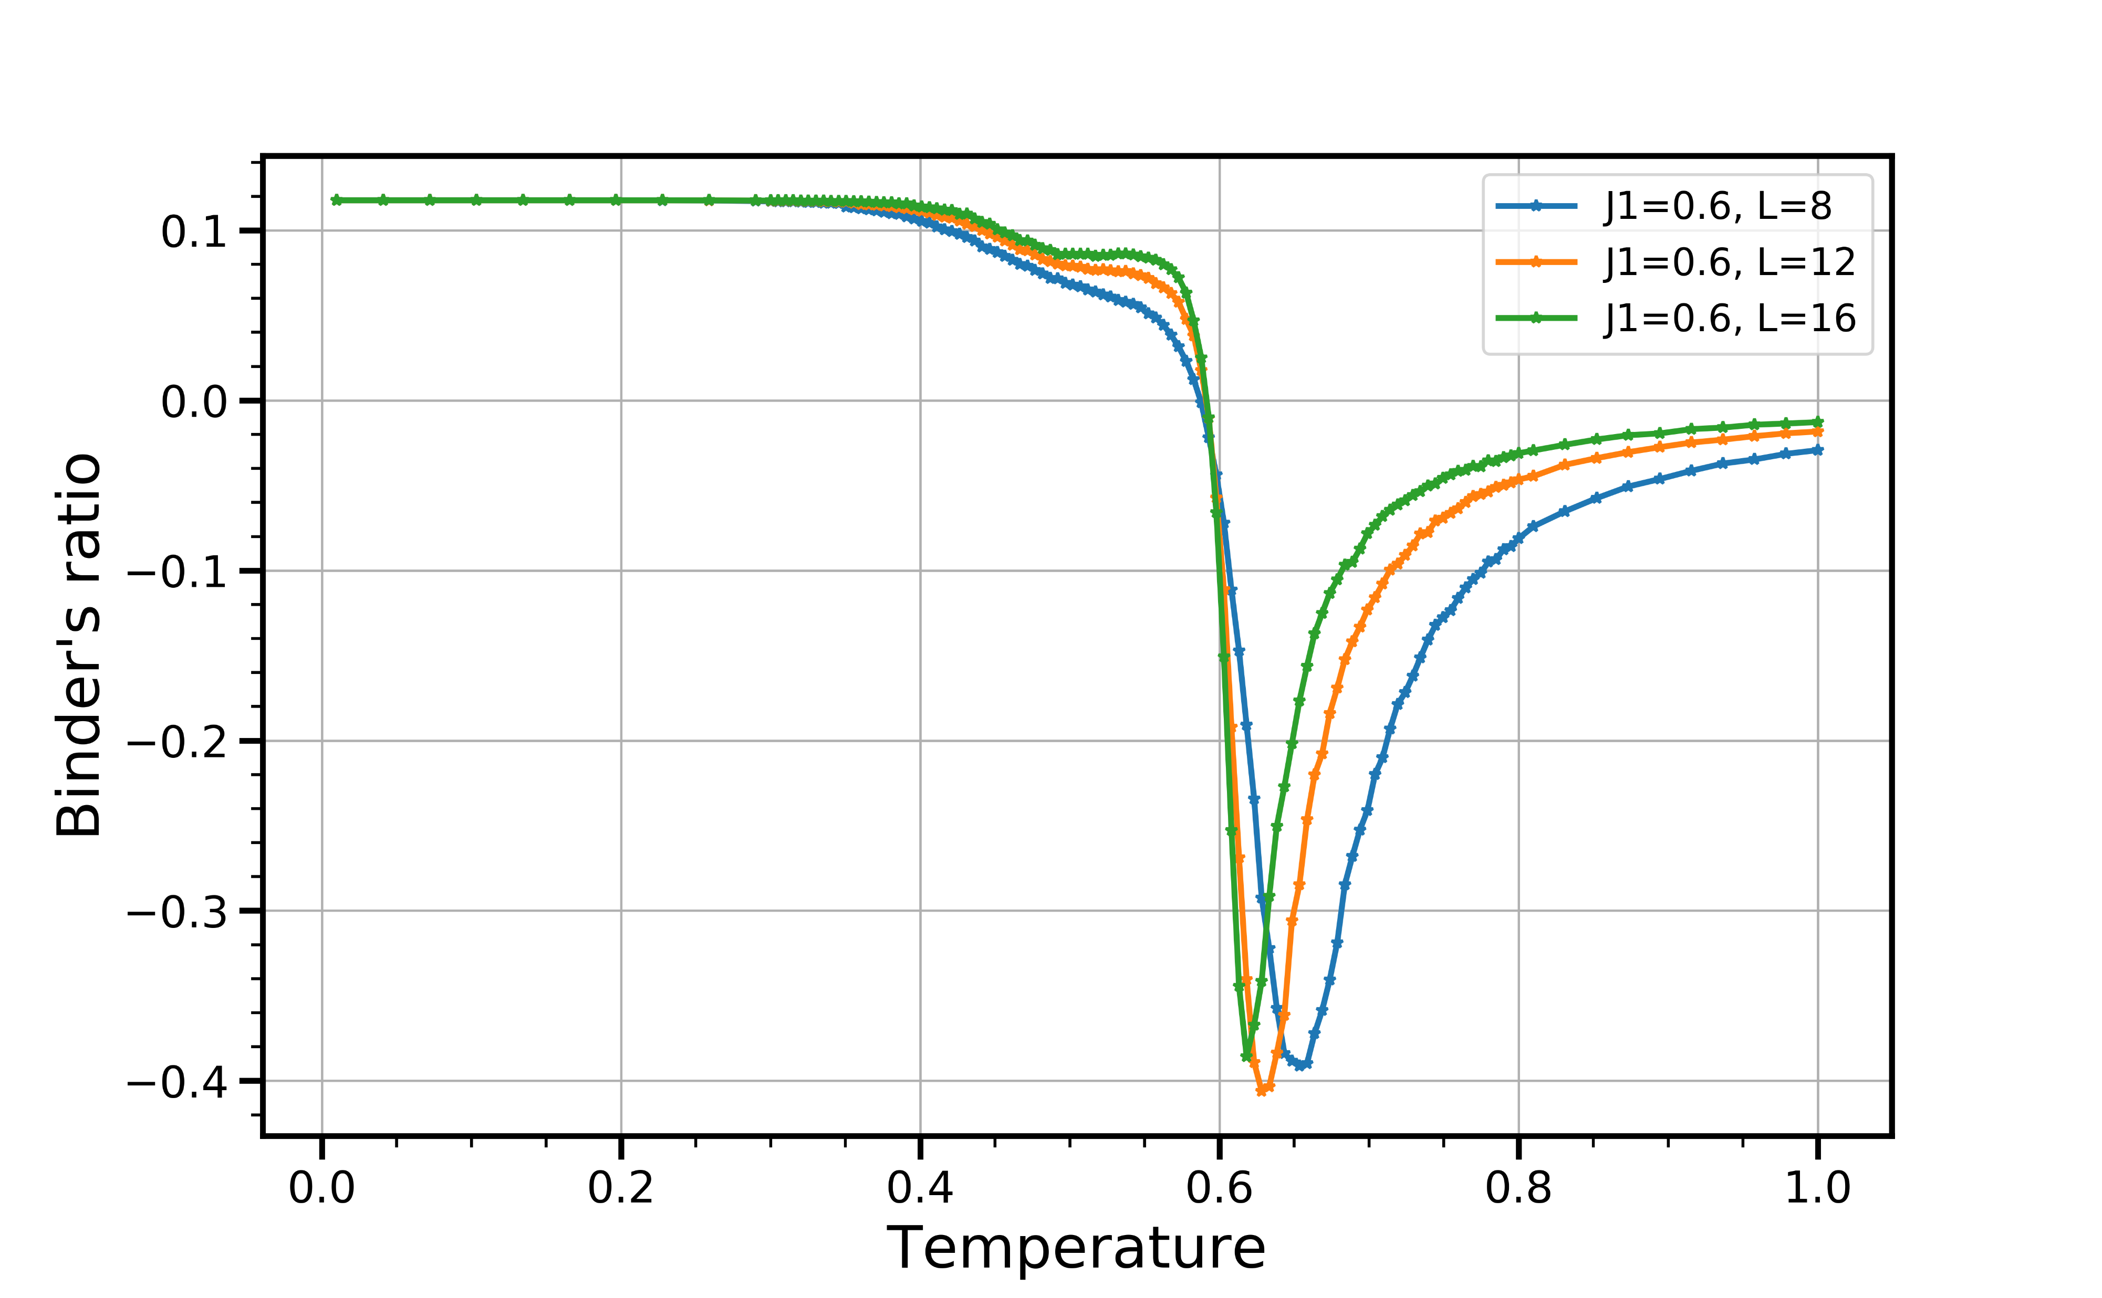
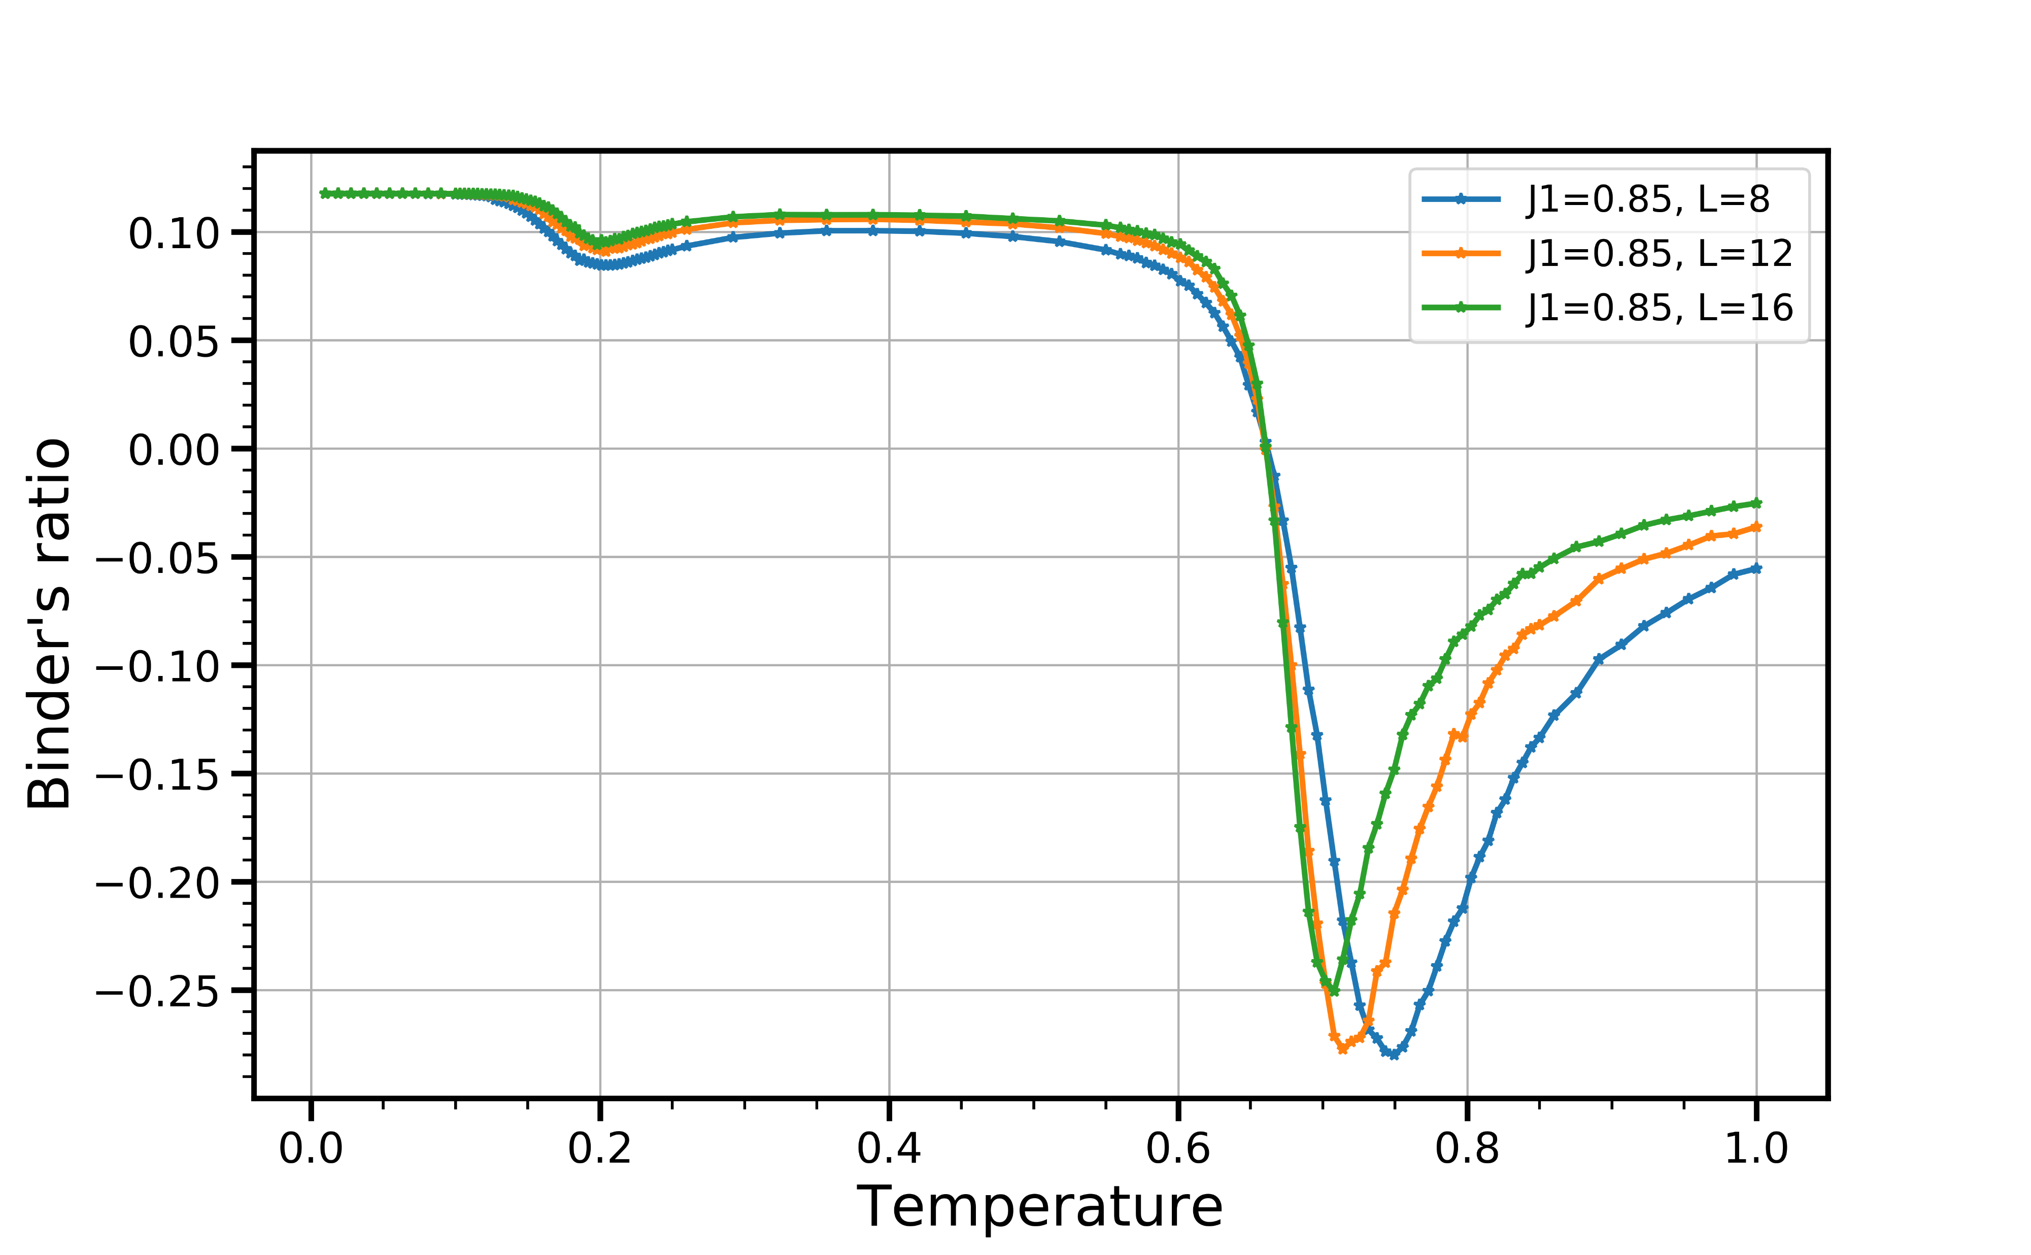
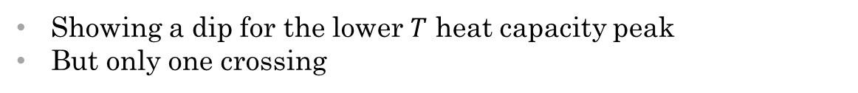
Binder’s Ratio Result
Showing a dip for the lower $T$ heat capacity peak
But only one crossing

Slide 24
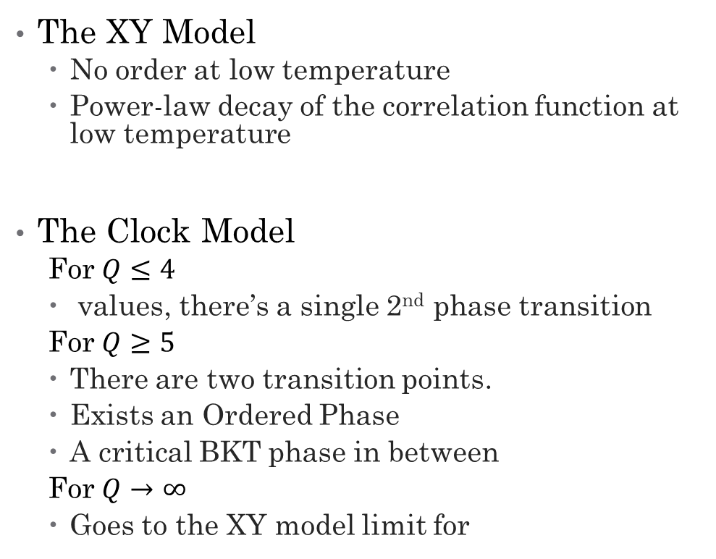
KT Phase – XY model & Clock Model
The XY Model
No order at low temperature
Power-law decay of the correlation function at low temperature
The Clock Model
For $Q≤4$
values, there’s a single 2nd phase transition
For $Q≥5$
There are two transition points.
Exists an Ordered Phase
A critical BKT phase in between
For $Q→∞$
Goes to the XY model limit for

Slide 25
Low Q Results

Slide 26
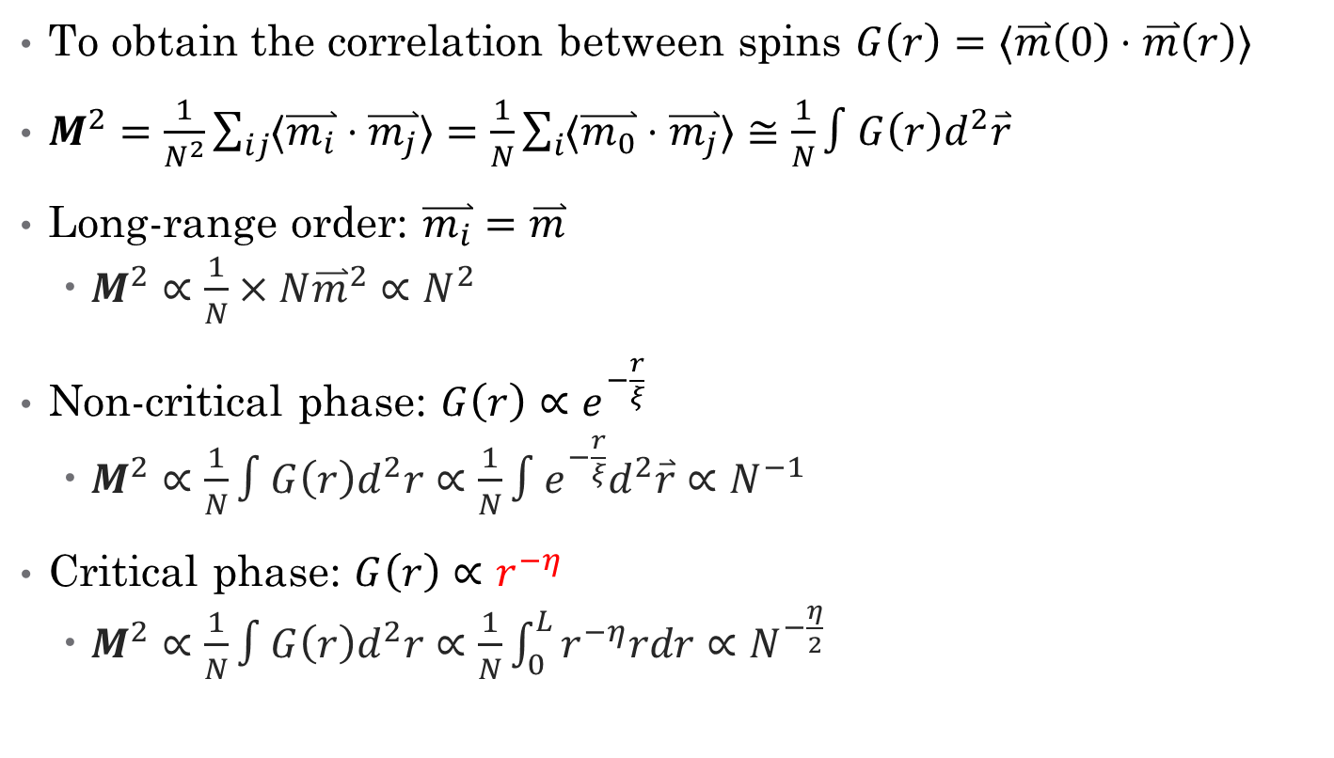
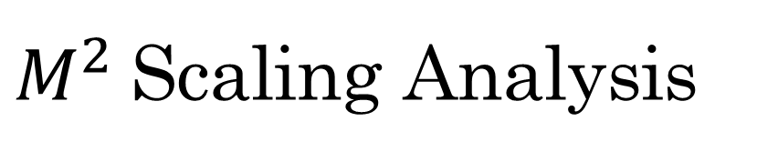
$M^{2}$Scaling Analysis
To obtain the correlation between spins $G\left(r\right)=⟨\overset{⃑}{m}\left(0\right)⋅\overset{⃑}{m}\left(r\right)⟩$
$M^{2}=\frac{1}{N^{2}}\sum_{ij}{⟨\overset{⃑}{m_{i}}⋅\overset{⃑}{m_{j}}⟩}=\frac{1}{N}\sum_{i}{⟨\overset{⃑}{m_{0}}⋅\overset{⃑}{m_{j}}⟩}≅\frac{1}{N}∫G\left(r\right)d^{2}\overset{⃑}{r}$
Long-range order: $\overset{⃑}{m_{i}}=\overset{⃑}{m}$
$M^{2}∝\frac{1}{N}×N{\overset{⃑}{m}}^{2}∝N^{2}$
Non-critical phase: $G\left(r\right)∝e^{−\frac{r}{ξ}}$
$M^{2}∝\frac{1}{N}∫G\left(r\right)d^{2}r∝\frac{1}{N}∫e^{−\frac{r}{ξ}}d^{2}\overset{⃑}{r}∝N^{−1}$
Critical phase: $G\left(r\right)∝r^{−η}$
$M^{2}∝\frac{1}{N}∫G\left(r\right)d^{2}r∝\frac{1}{N}\int_{0}^{L}{r^{−η}rdr}∝N^{−\frac{η}{2}}$

Slide 27
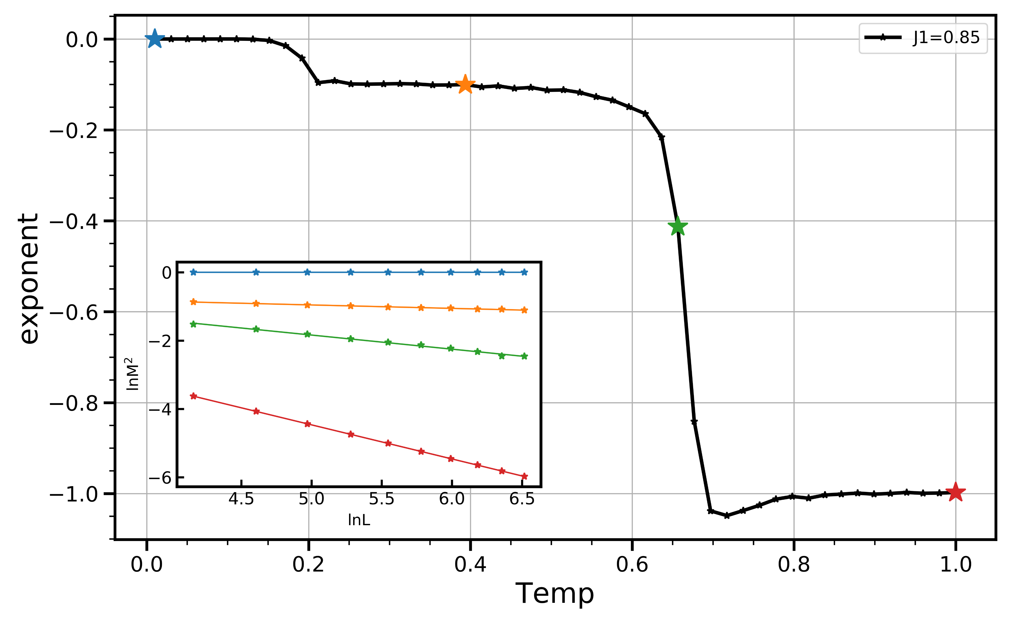
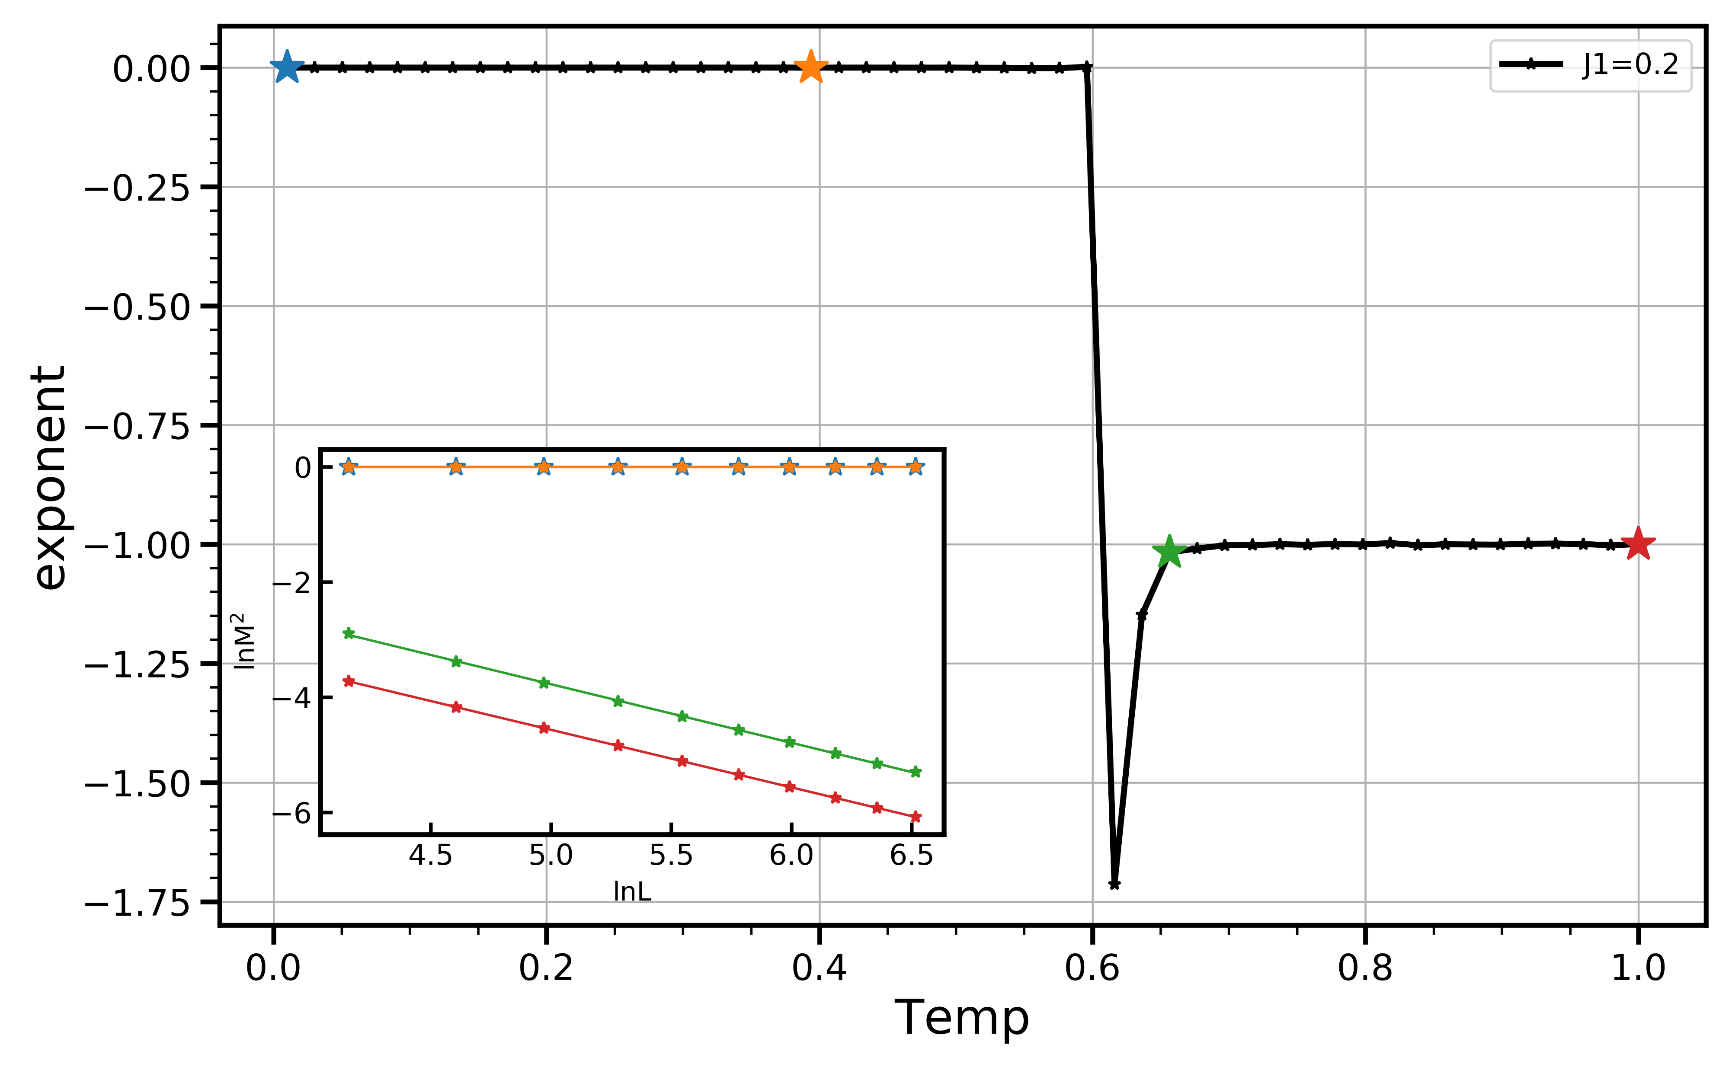
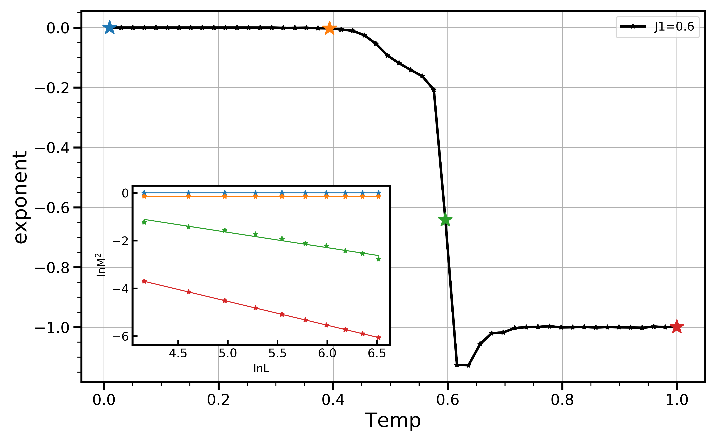
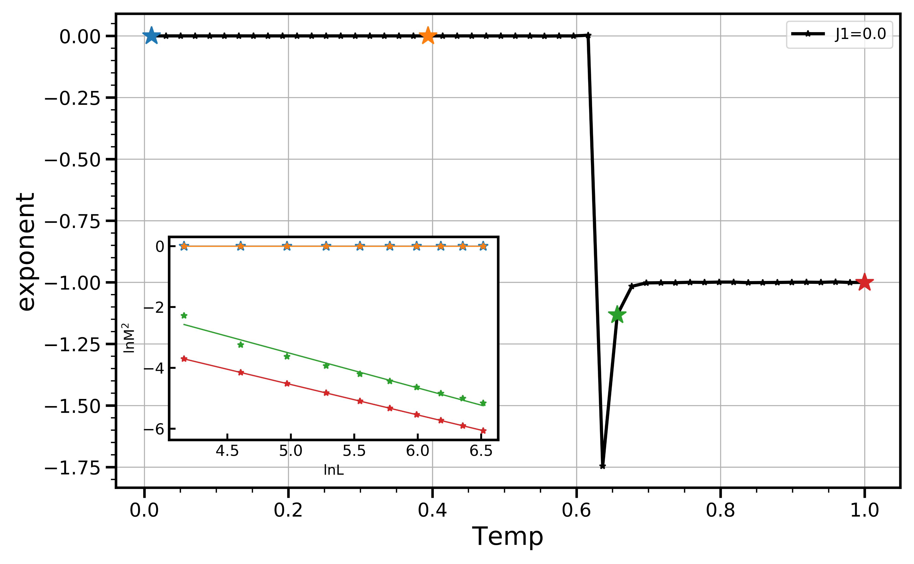
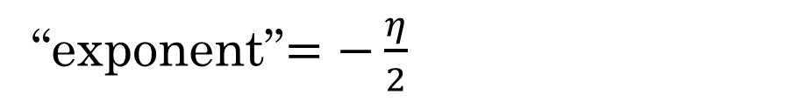
“exponent”$=−\frac{η}{2}$

Slide 28
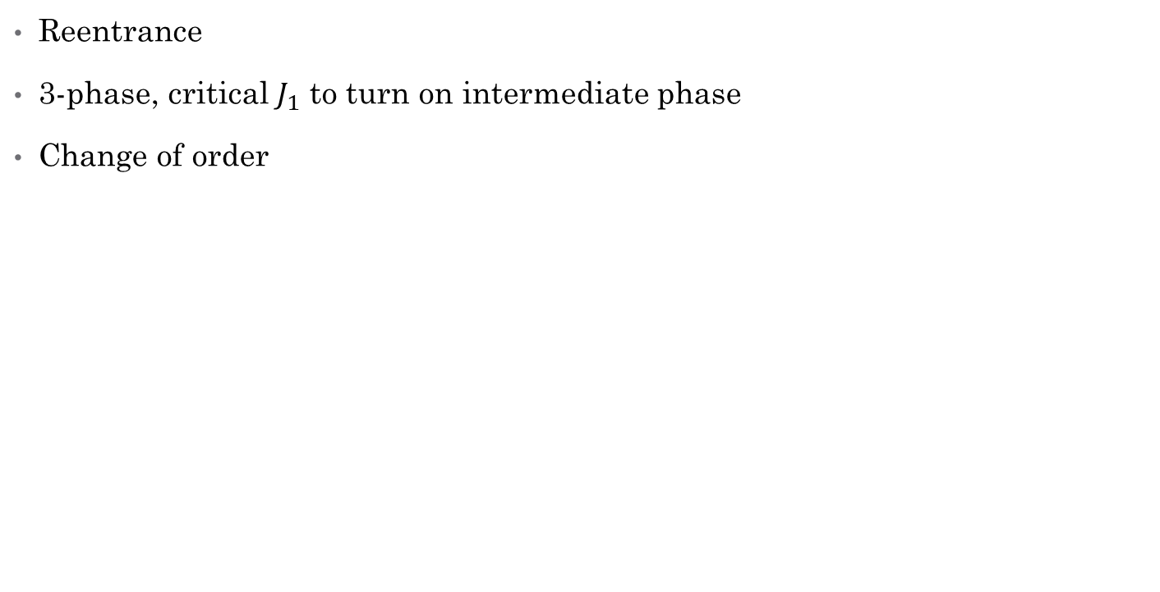
Rough Phase Diagram
Reentrance
3-phase, critical $J_{1}$ to turn on intermediate phase
Change of order

Slide 29
Future Plan
Start to do QMC, good initial project
Chunhan’s started QMC, I can help with
Quantum tight binding models, SU(N) Hubbard model? Constraint path qmc?

Slide 30

Thank You!

Slide 31
Outline
What is Synthetic Dimensions?
Phase Transitions in General
My Model
Methodology: Classical Monte Carlo
MCMC, Wolff Algorithm
Results
Future Plan

Slide 32
Outline
What is Synthetic Dimensions?
Phase Transitions in General
My Model
Methodology: Classical Monte Carlo
Results
Energy, Heat Capacity
Finite Size Scaling
Rough Phase Diagram
Future Plan

Slide 33
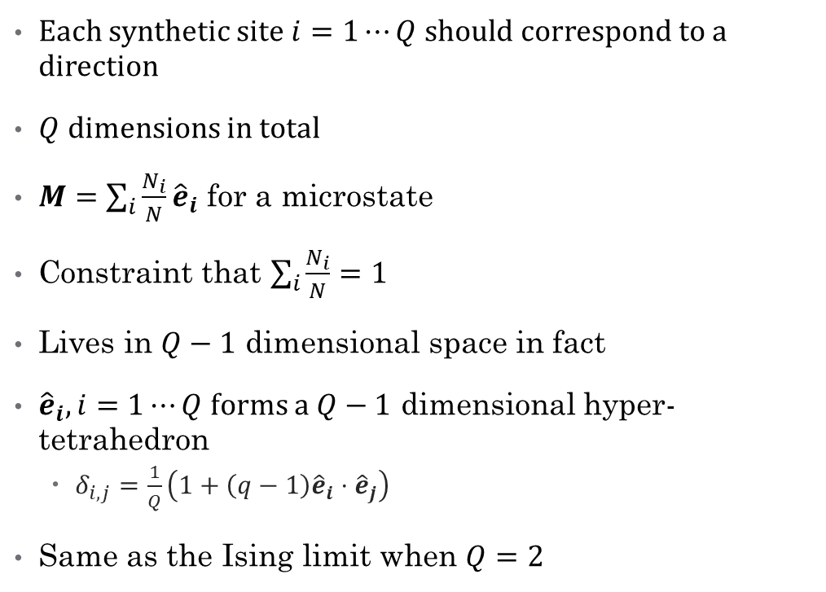
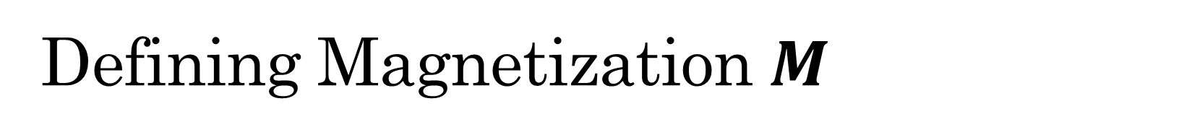
Defining Magnetization $M$
Each synthetic site $i=1⋯Q$ should correspond to a direction
$Q$ dimensions in total
$M=\sum_{i}{\frac{N_{i}}{N}}{\hat{e}}_{i}$ for a microstate
Constraint that $\sum_{i}{\frac{N_{i}}{N}}=1$
Lives in $Q−1$ dimensional space in fact
${\hat{e}}_{i},i=1⋯Q$ forms a $Q−1$ dimensional hyper-tetrahedron
$δ_{i,j}=\frac{1}{Q}\left(1+\left(q−1\right){\hat{e}}_{i}⋅{\hat{e}}_{j}\right)$
Same as the Ising limit when $Q=2$

Slide 34
Data collapse analysis-Back up

Slide 35
Simulation Results
Energy

